Slide 1
Docbook : A Doctor Appointment System
MD. Al-Amin Patwary
ID:191-15-2495
Department of CSE
Daffodil International University
Project Supervisors
Dr. Arif Mahmud
Department of Computer Science & Engineering
Project Co-Supervisors
Mr. Mohammad Jahangir Alam
Department of Computer Science & Engineering

Slide 2
Outline:
1. Objective
2. Motivation
3. Requirement Analysis
4. Technology
5. System Use Case Diagram
6. ER Diagram
7. BPM Diagram
9. Future Scope
10. Conclusion

Slide 3
Objectives
To reduce human error and overall cost.
To save time by making the appointment process faster.
Secure User Authentication, confidential information.
Device Compatibility, Works on computers, Smartphones, anytime access.
System flexibility, handles more users, adaptable for future.

Slide 4
Motivation
The motivation for developing this system comes from observing the common problems in traditional healthcare appointment processes. We realized that while many sectors have already been transformed through technology, doctor appointment systems are still mostly manual. This gap inspired me to build a platform where:
A smart digital platform for search hospitals & doctor details
Check availability in real-time
Book appointments anytime from anywhere

Slide 5
Requirement Analysis
To build an effective healthcare system, I analyzed the key requirements:
Secure User Login
Easy Appointment Booking
Doctor Profiles with specialization and availability
Secure online payment system.
Hospital information with services
Mobile-friendly design
Strong data security
Advanced Search Options
Scalability for future growth

Slide 6
Technology
This project is built using
  Front End: React.js
  Back End: NodeJs, ExpressJs and MongoDB
  UI Design: Material UI
  Package Management: NPM

Slide 7
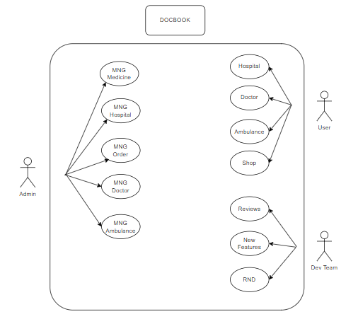
System Use Case Diagram

Slide 8
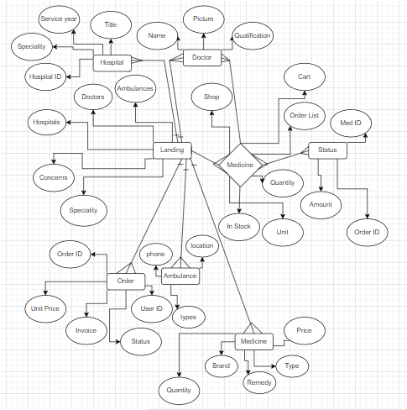
ER Diagram

Slide 9
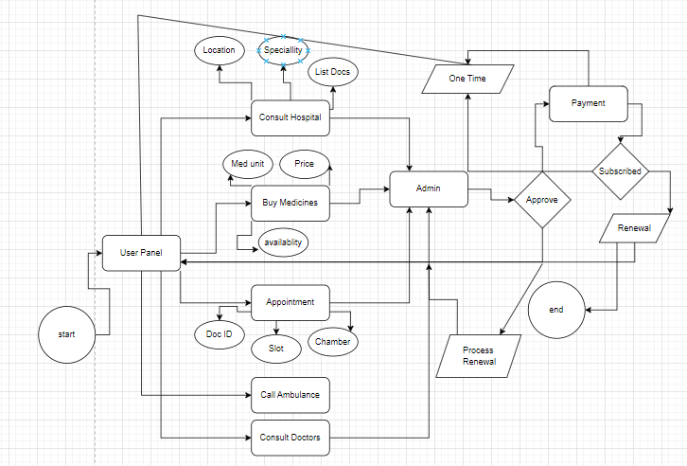
BPM Diagram

Slide 10
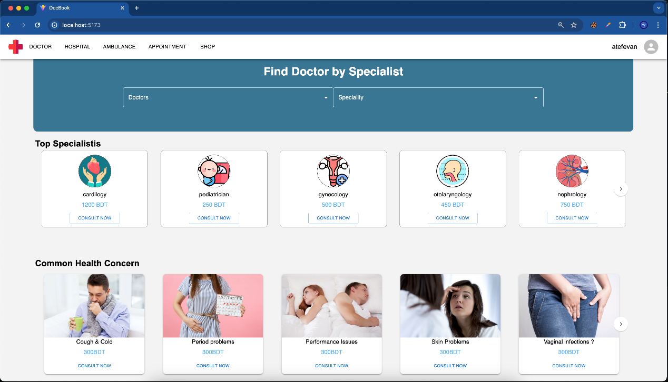
Landing
Figure 01: Home Page of the Docbook

Slide 11
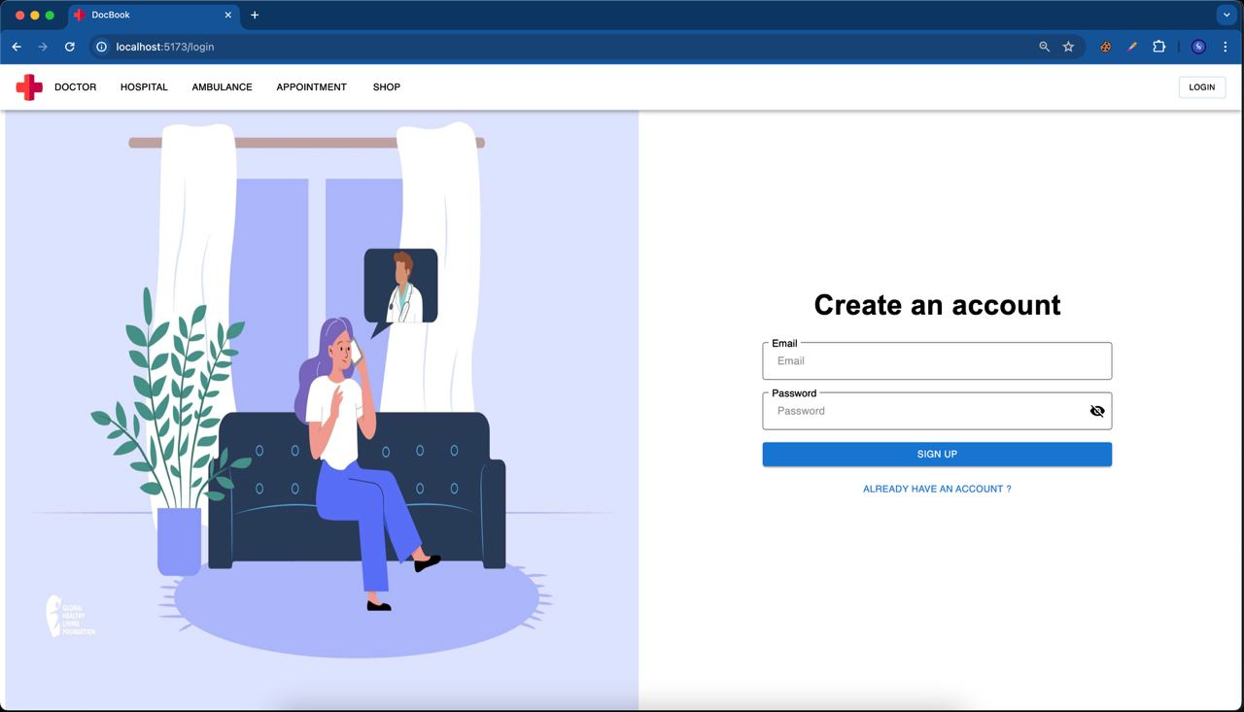
Authentication
Figure 02: Login and Signup Page

Slide 12
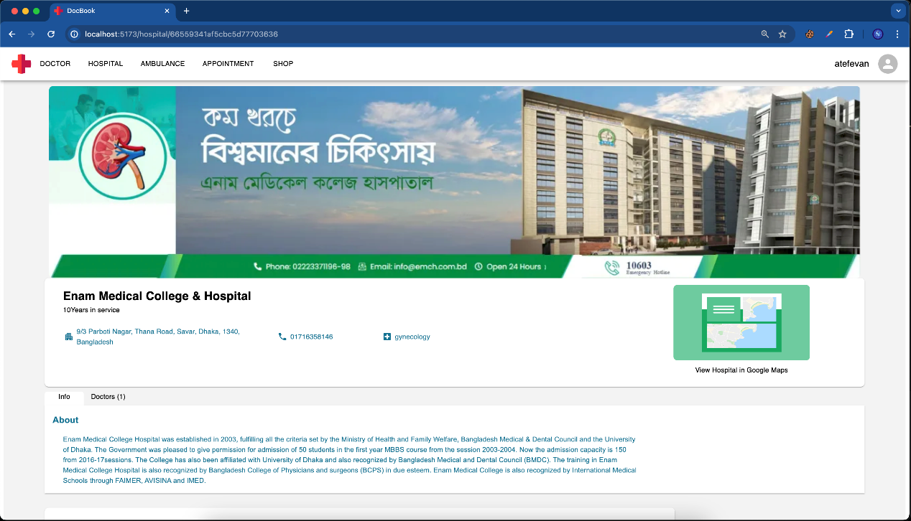
Hospital Details
Figure 03: Hospital details page

Slide 13
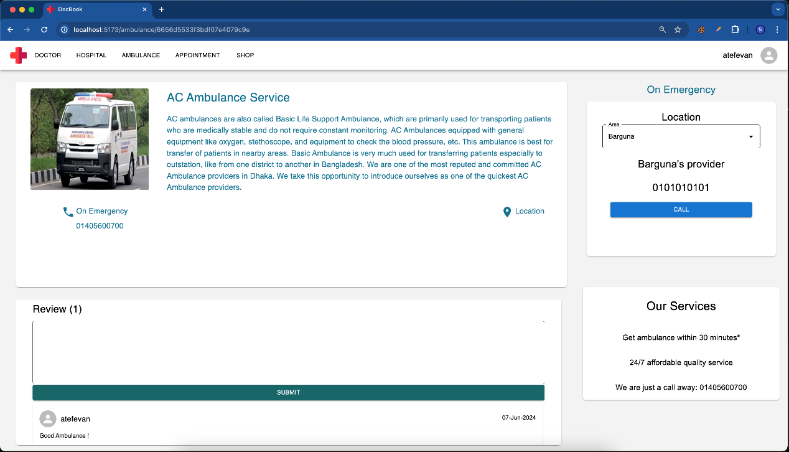
Emergency Ambulance
Figure 04: Ambulance details page

Slide 14
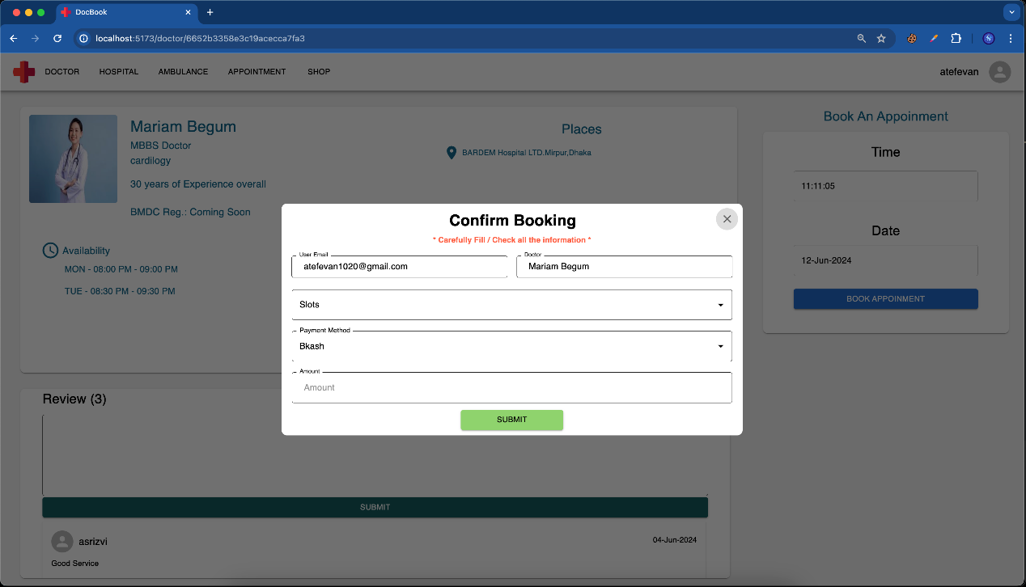
Book appointment
Figure 05: Booking an appointment

Slide 15
Future Scope
In the future,
Virtual doctor consultation.
Suggesting doctors based on patient history.
Add multiple language options
Improve patient reviews and ratings.

Slide 16
Conclusion
In conclusion, DocBook makes healthcare access faster and easier. Users can find doctors, check availability, and book appointments from anywhere — reducing waiting time and stress. This system helps doctors and hospitals work more efficiently as well.

Slide 17
Thank You

Slide 18
docbook-client
https://tinyurl.com/docbook-admin

