Slide 1
NextGen IMS : AI-Driven Inventory System with Predictive Stock Analytics
MD. Rakibul Hassan
ID: 191-15-2479
Department of CSE
Daffodil International University
Project Supervisors
Dr. Abdus Sattar
Department of Computer Science & Engineering
Project Co-Supervisors
Mr. Mohammad Jahangir Alam
Department of Computer Science & Engineering

Slide 2
Outline
1. Introduction
2. Objective
3. Motivation
4. Expected Outcomes
4. Requirement Analysis
5. Technology
6. System Use Case Diagram
7. ER Diagram
8. BPM Diagram
9. Explaining with Project Screenshots.
10. Future Scope
11. Conclusion

Slide 3
Objectives
To develop an intelligent Inventory System.
To integrate AI-based predictive suggestions and analytics.
To reduce human error and operational inefficiency.
To provide a modern, responsive, and user-friendly dashboard.
To support data-driven decision making.
To offer a scalable solution.

Slide 4
Motivation
The motivation for this project is to remove the complexity from traditional inventory management and introduce an intelligent predictive system. Our goal is to minimize operational delays, reduce financial loss from overstock or shortages, and improve overall business performance using artificial intelligence. With centralized data and AI-driven analytics, this system empowers decision-makers to manage inventory more confidently and efficiently.

Slide 5
Expected Outcomes
Efficient Stock Monitoring
Streamlined Purchase Order Management
Enhanced Supplier, Category & Product Management
AI-Powered Inventory Insights
Accurate Transaction History
Increased Organizational Productivity

Slide 6
Requirement Analysis
User Login: Secure authentications for admins, managers, and staff members.
Dashboard: Centralized view of stock status, analytics, and recent activities with charts.
Inventory System: Add, edit, delete and view products with SKU, category, supplier details and purchase orders.
Stock Tracking: Manage stock-in, stock-out, and adjustments with real-time updates.
AI Predictions: Predict and suggest product descriptions, categories, and adjustment reasons using AI insights.
Low Stock Alerts: Automatic alerts for low stock levels based on re-order values.
Reports: Generate and export sales transactions and analytics reports.
Role-Based Access: Different permission levels for admin, manager and stuffs.
Scalability & Security: Securely handle and scale growing data with protected access.

Slide 7
Technology
Front End : Next.js (React Framework)
Back End : Next.js API Routes
Database: MongoDB (Mongoose)
UI Design : Tailwind CSS + Shad CN
Package Manager: PNPM
Programming Language: TypeScript
AI Model: Gemini 2.0 Flash Lite (via Vercel’s AI SDK)

Slide 8
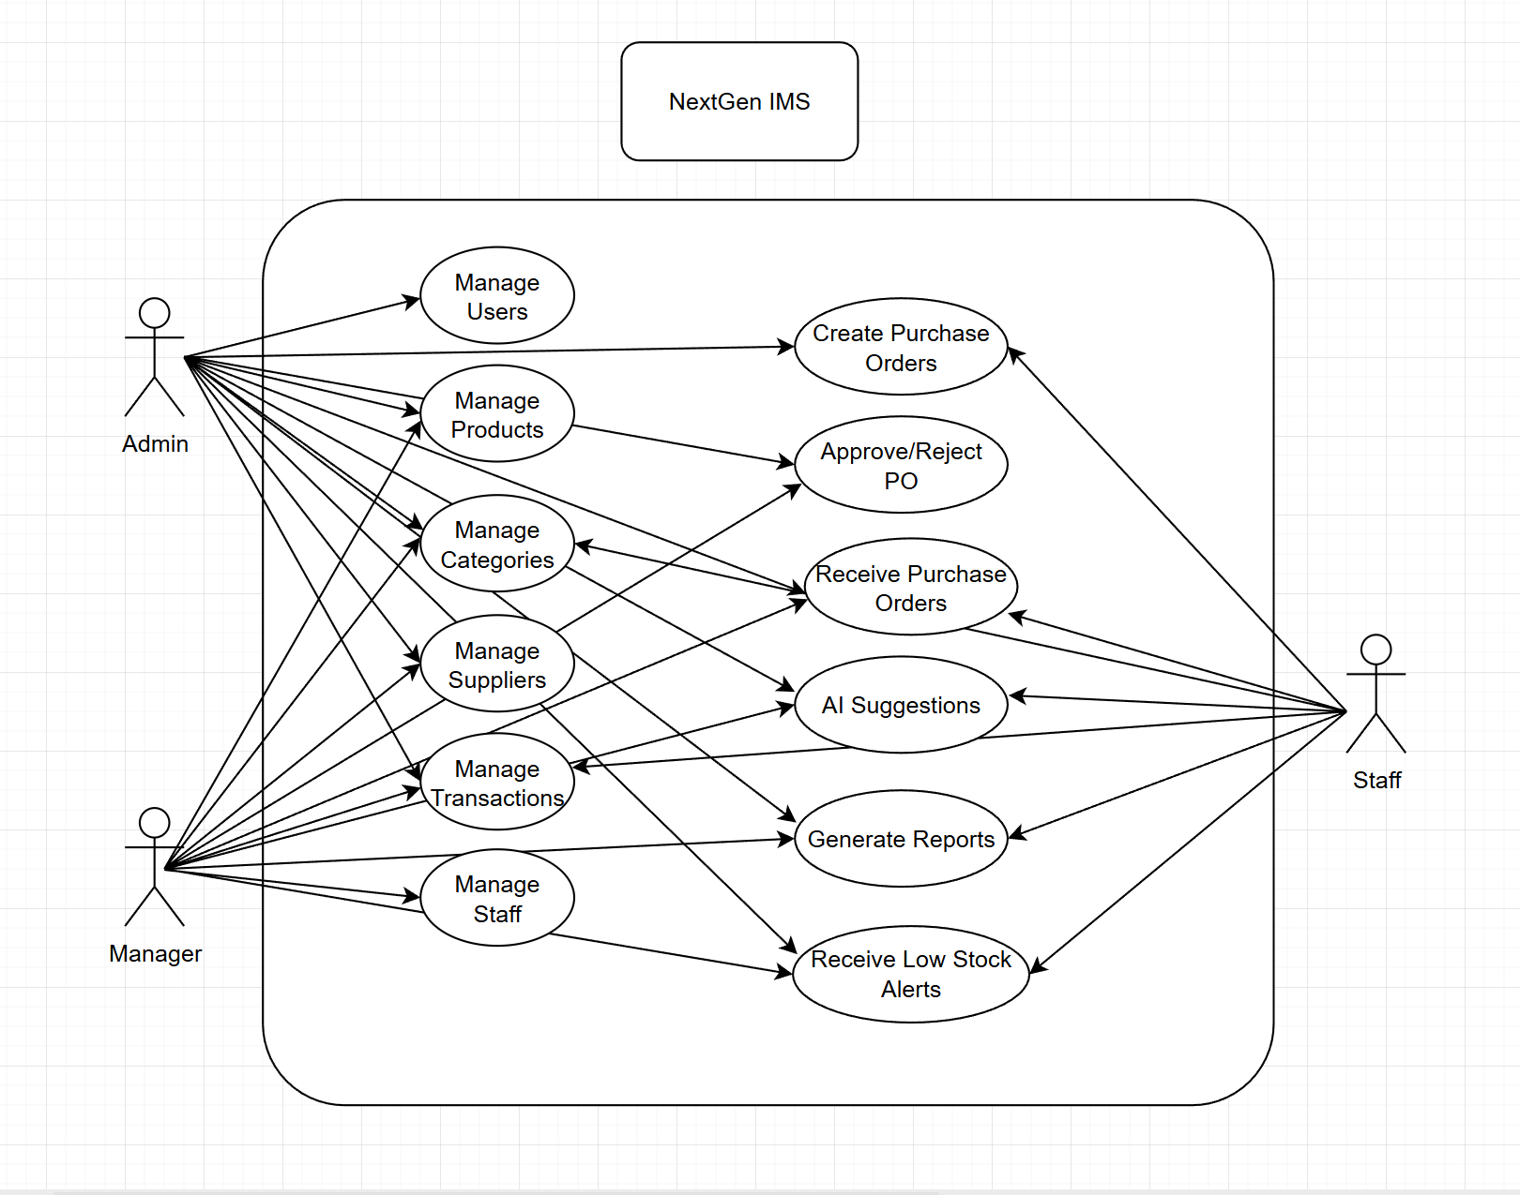
System Use Case Diagram

Slide 9
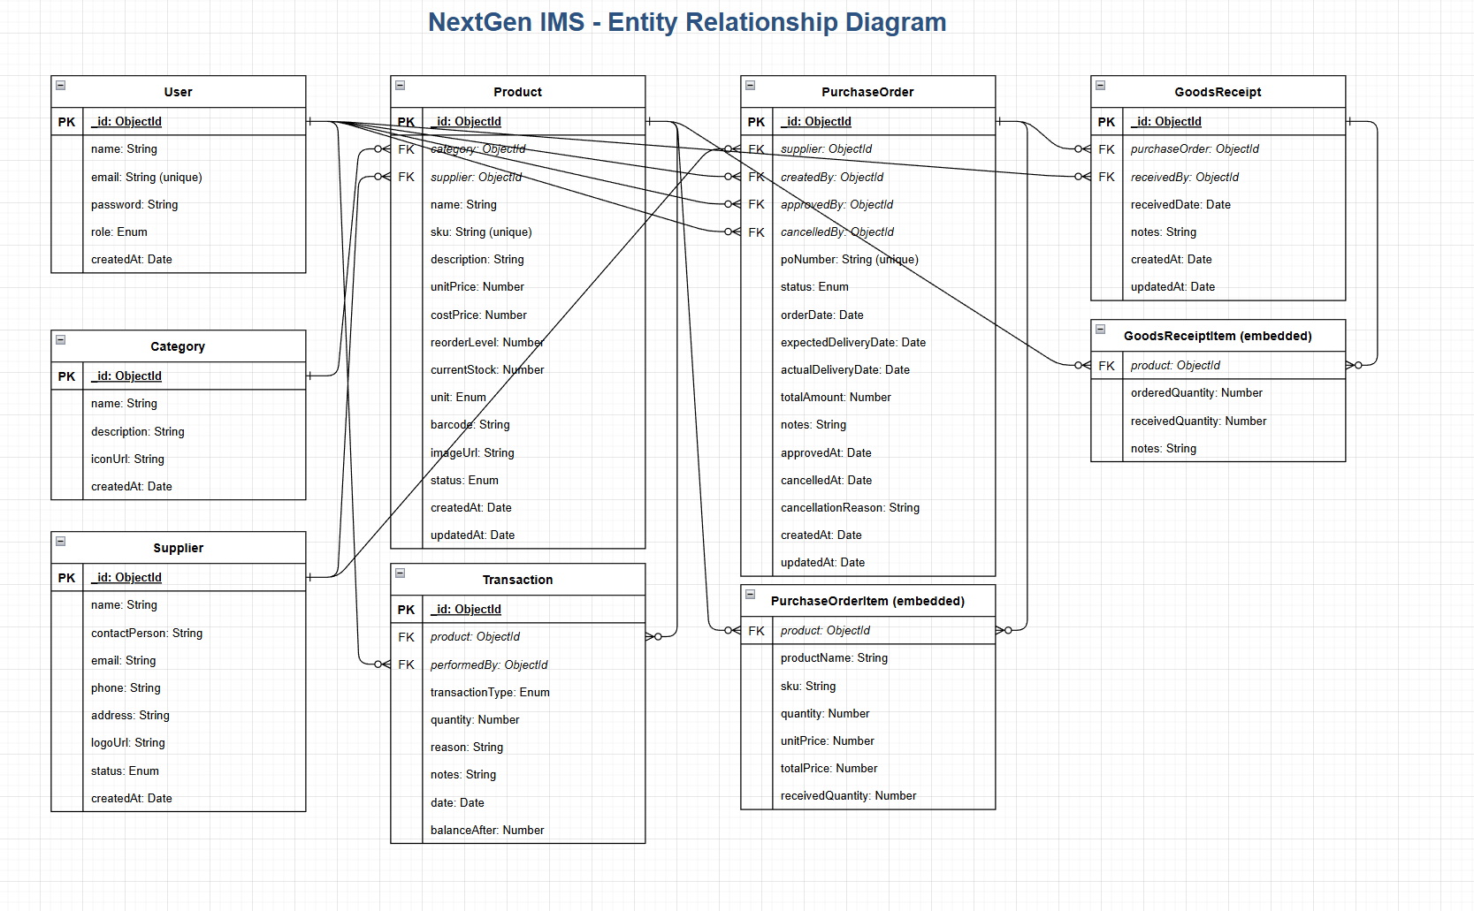
ER Diagram

Slide 10
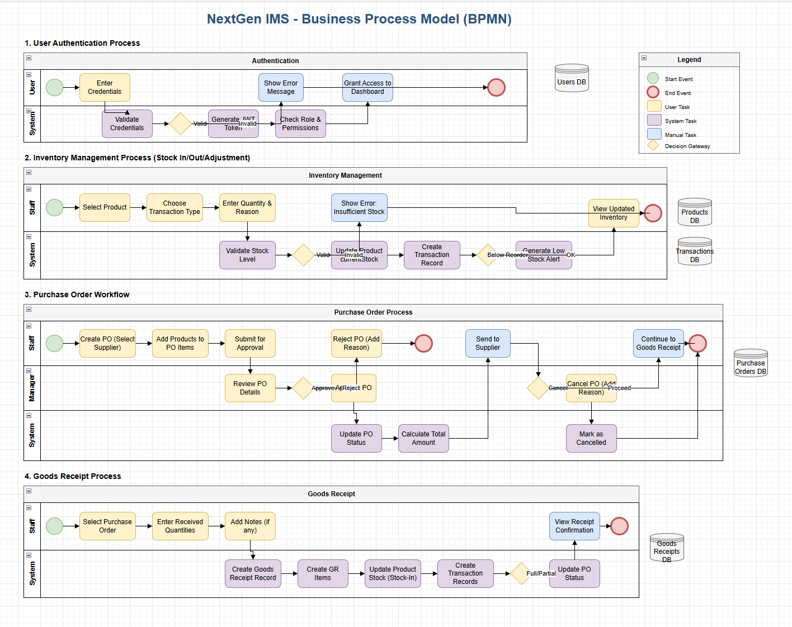
BPM Diagram

Slide 11
Implementation and Testing
Multiple testing methods were used to ensure the stability, accuracy, and reliability of the system.
Unit Testing
Integration Testing
User Interface Testing
Security Testing
Performance Testing

Slide 12
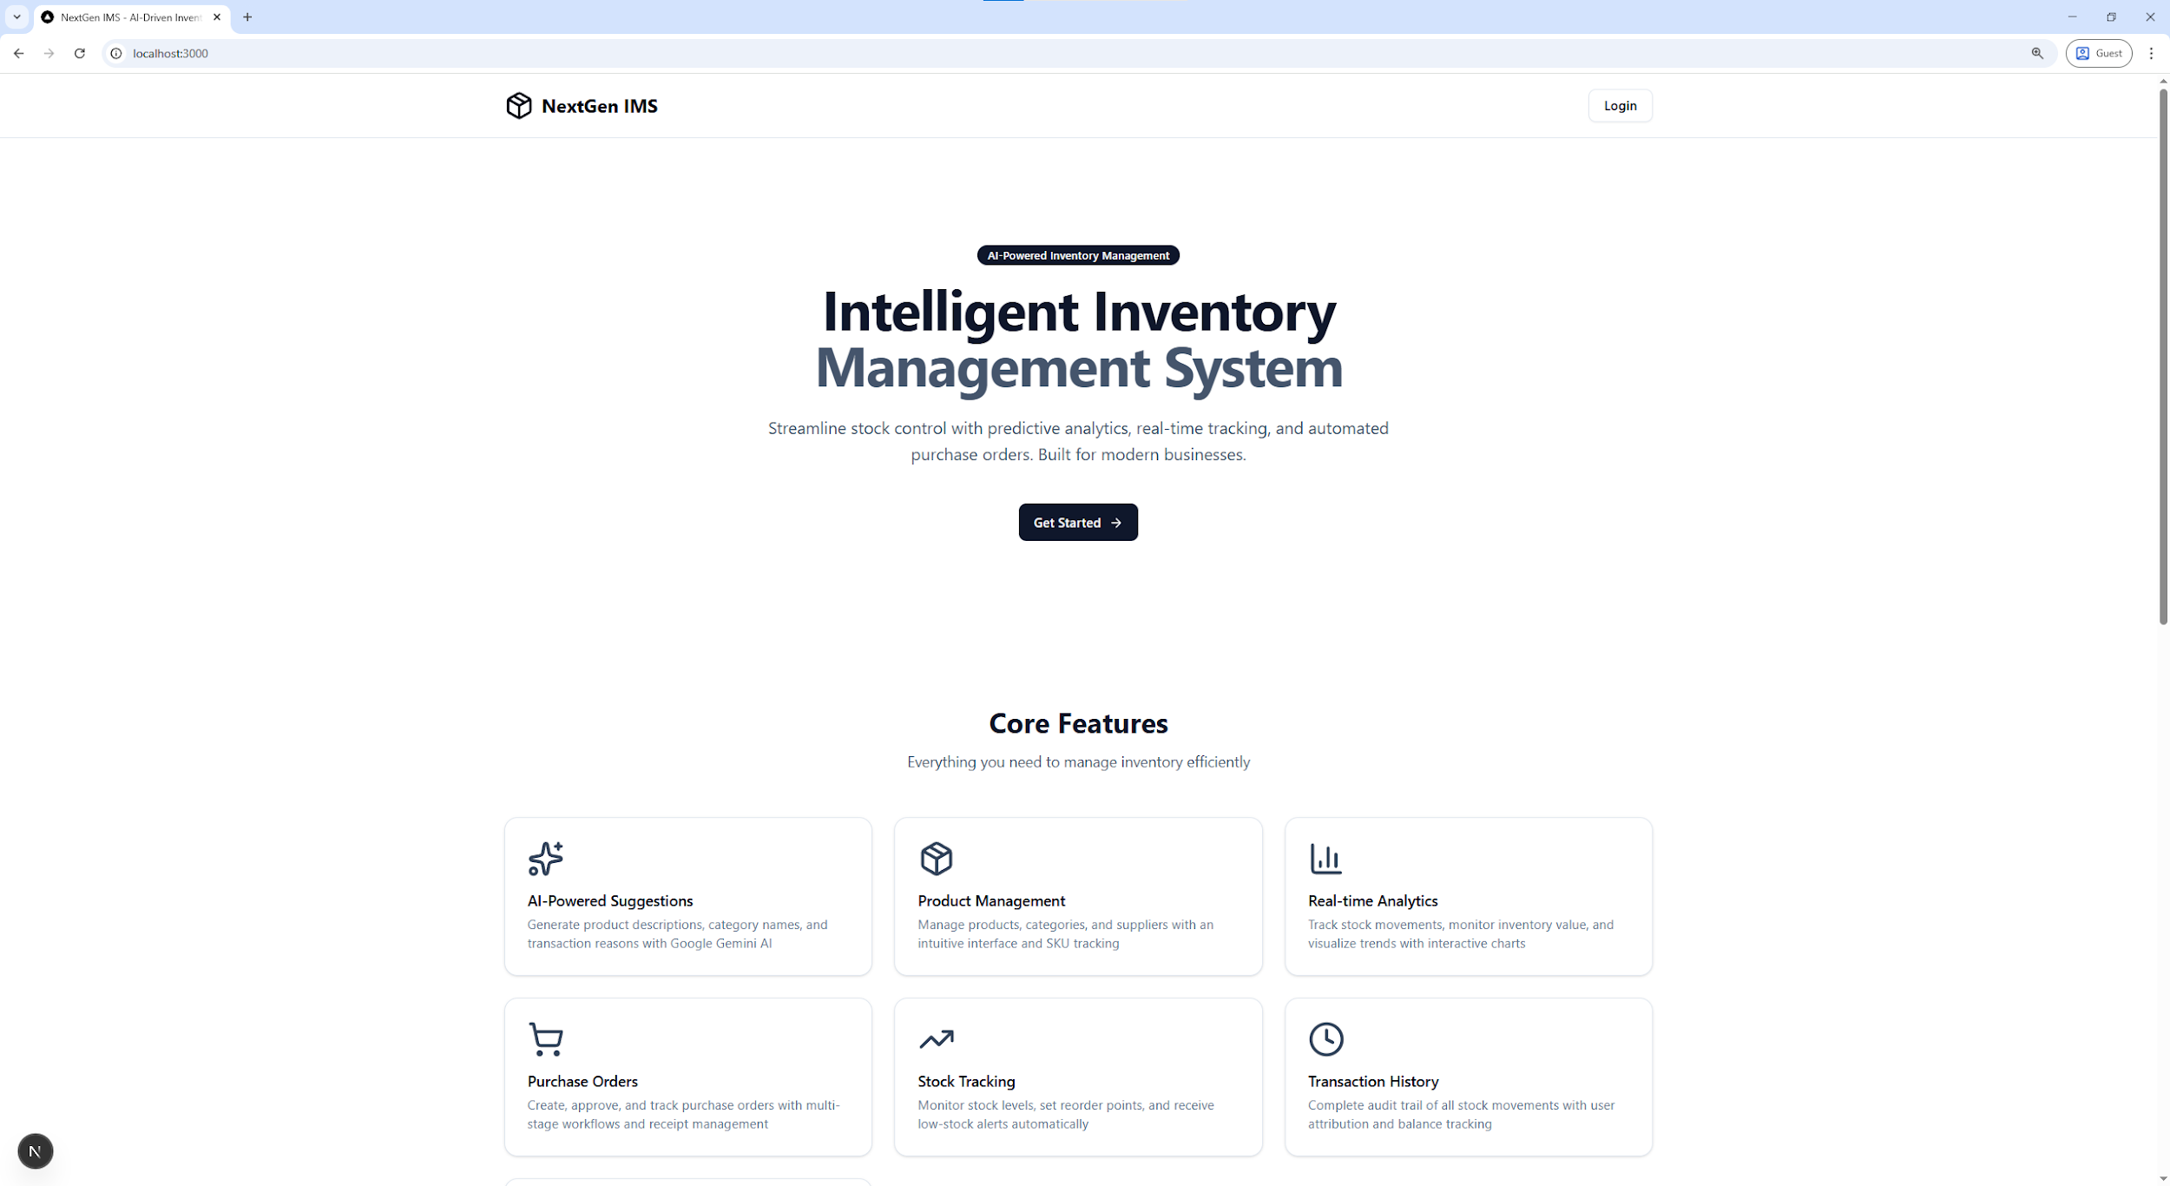
Landing Page
Figure 01: Landing Page of NextGen IMS

Slide 13
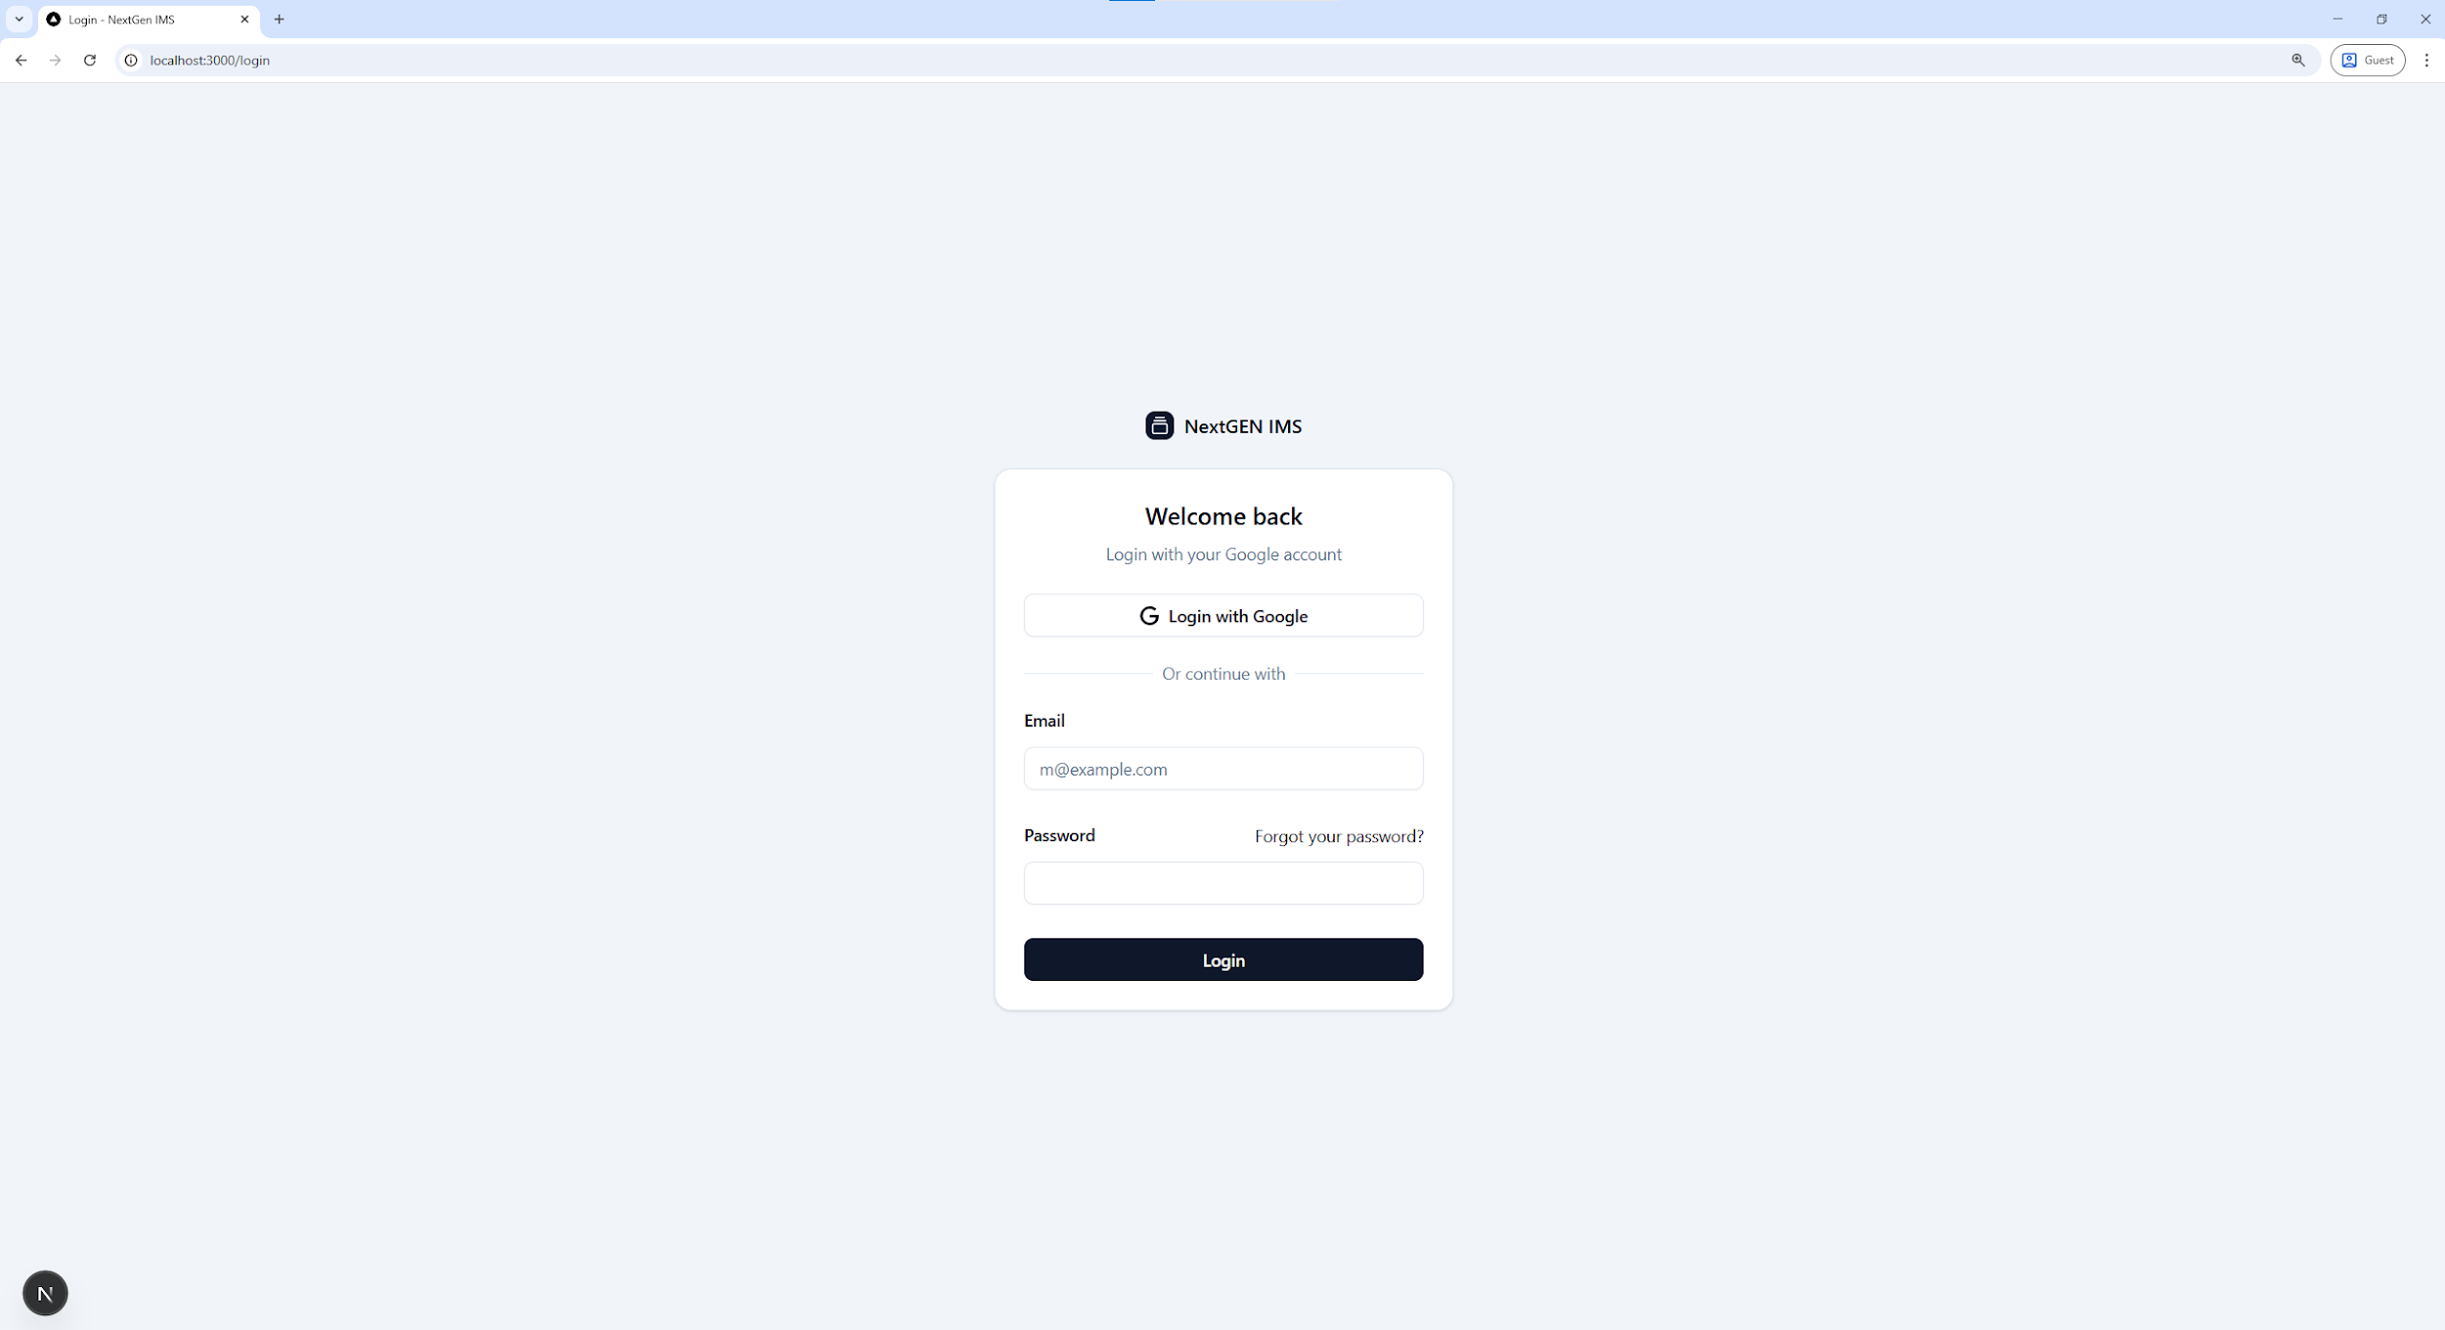
Authentication
Figure 02: Authentication or Login Page

Slide 14
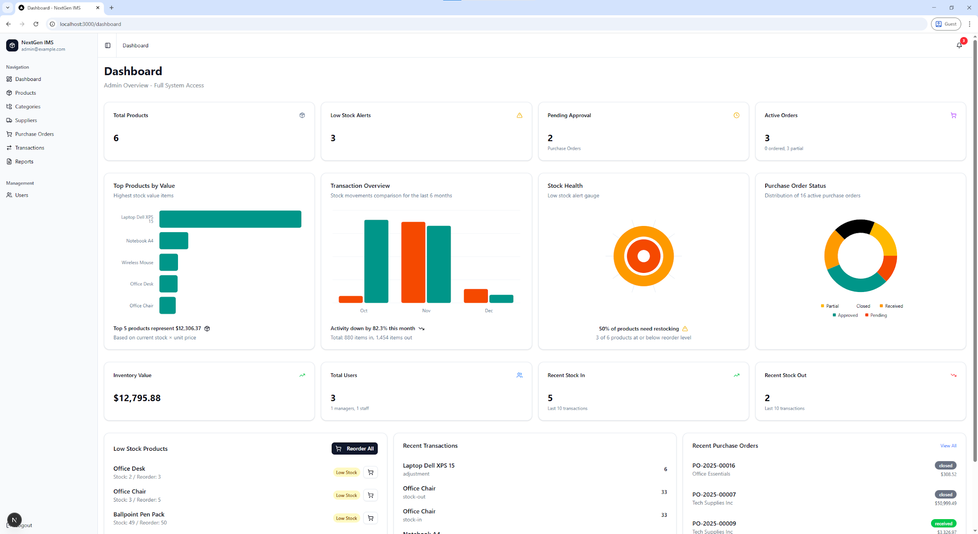
Dashboard
Figure 03: Hospital details page
Figure 03: Dashboard Page

Slide 15
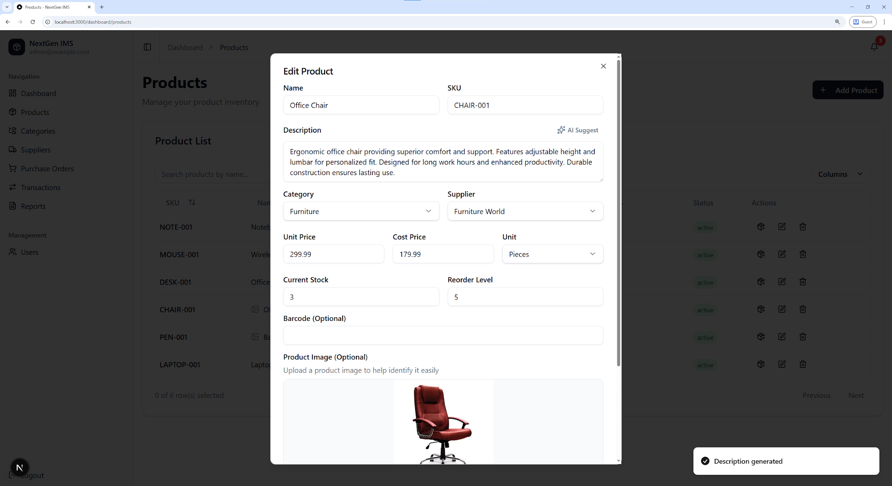
Edit Product
Figure 04: Edit Product with AI-Suggested Description

Slide 16
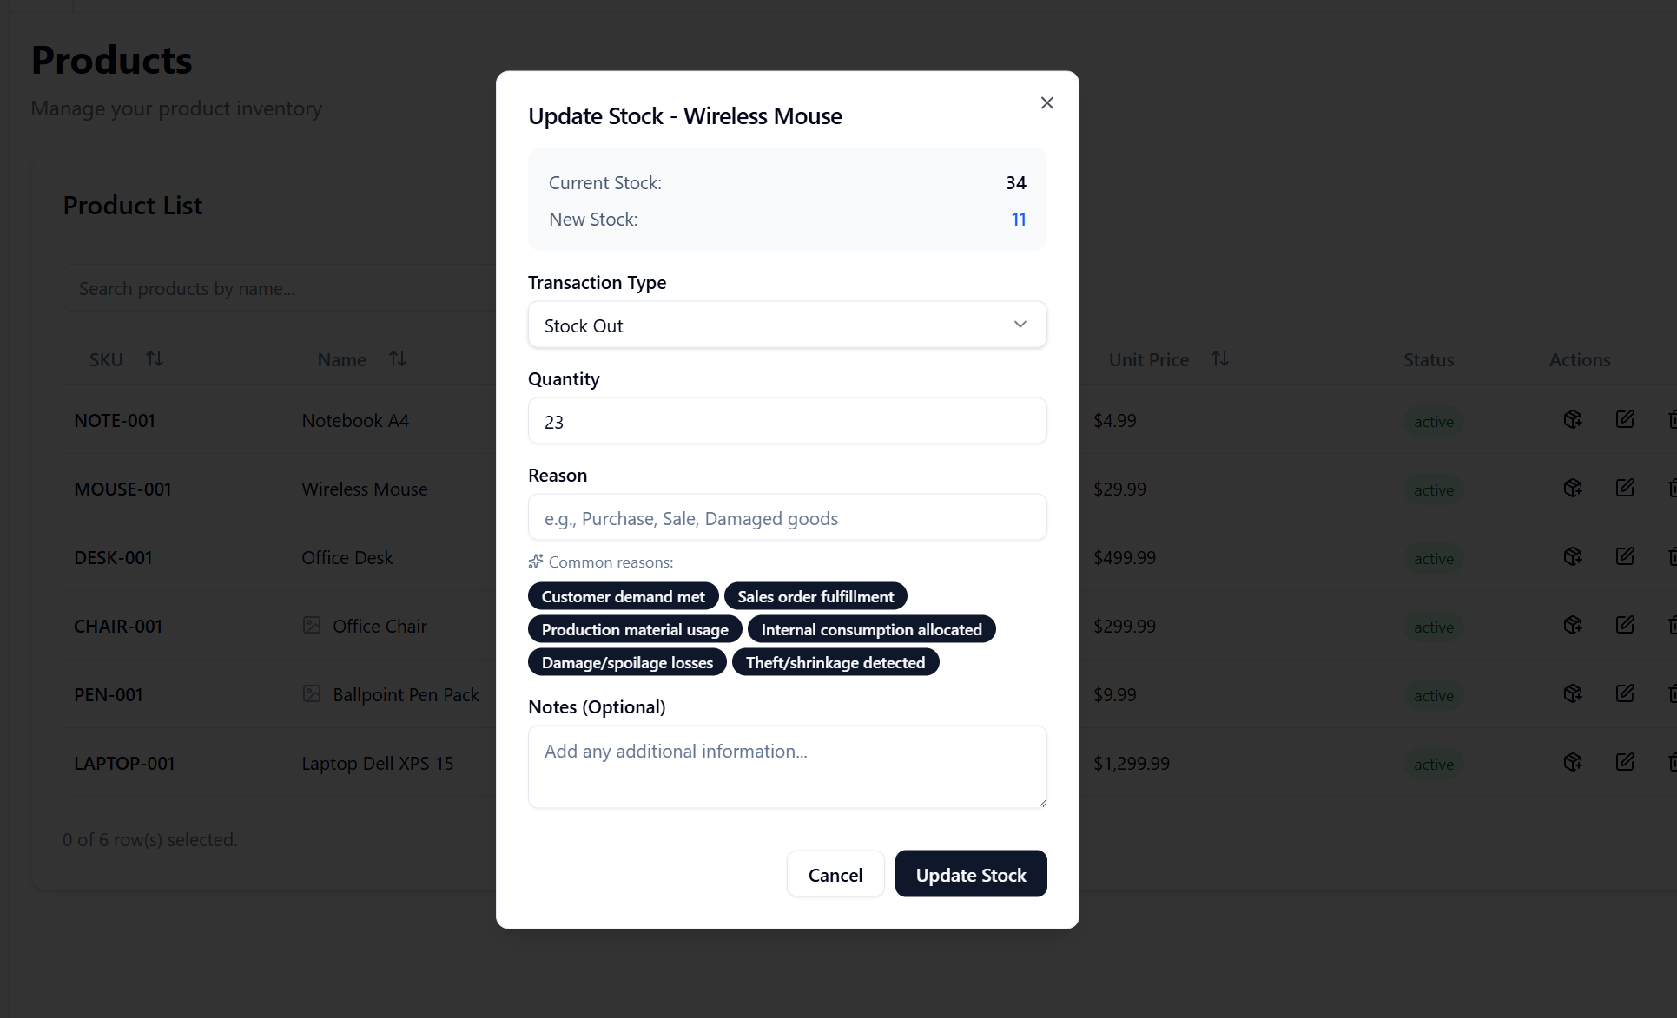
Update Stock
Figure 05: Update Stock with AI Suggested Reasons

Slide 17
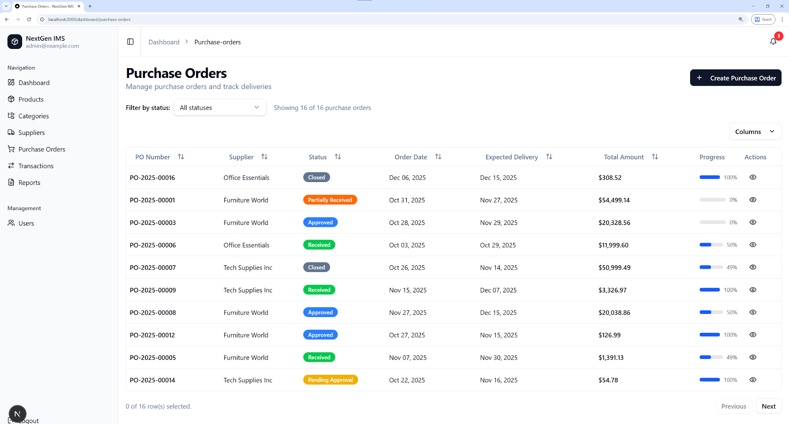
Purchase Order Management
Figure 06: Add/Approve/Receive/Manage Purchase Order

Slide 18
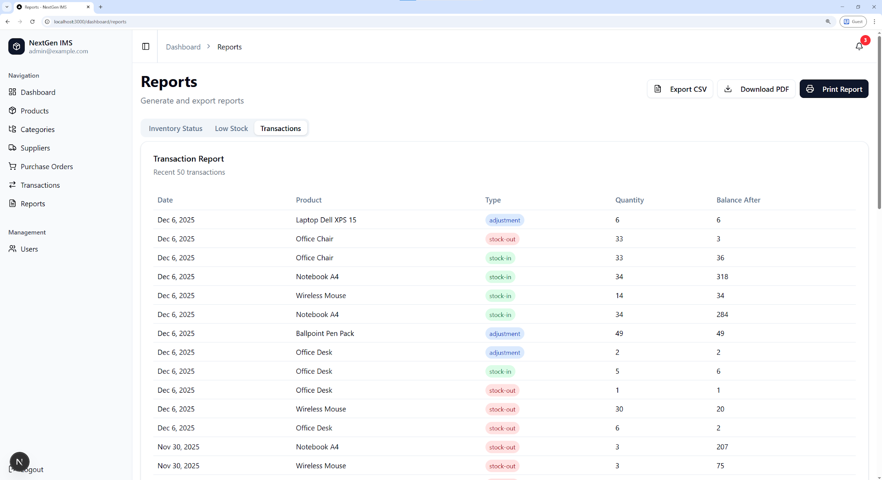
Report Generation
Figure 07: Export Report as CSV + PDF or Print Report

Slide 19
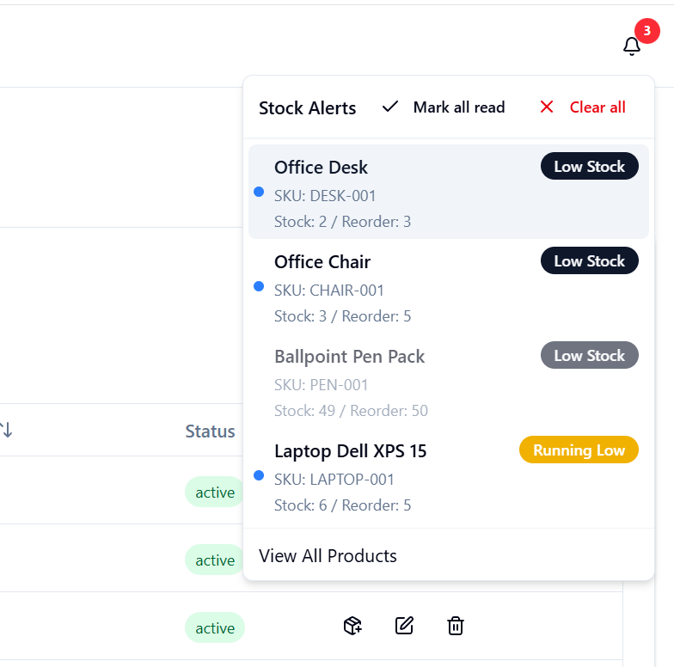
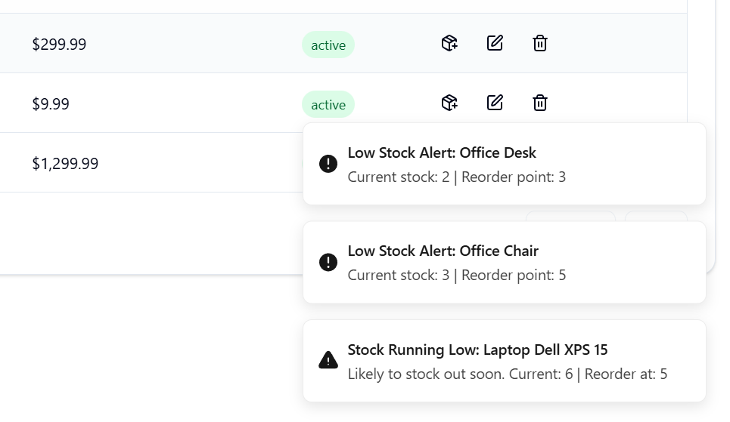
Smart Low Stock Alert
Figure 08: Predicted Low Stock Alert Based on Re-order value with live toast notification.

Slide 20
Future Scope
Add mobile app with barcode/QR scanning for easier stock handling
Integrate multi-warehouse support for large-scale operations
Implement RFID-based automated inventory tracking
Add multiple language options
Provide real-time supplier performance
Introduce advanced AI forecasting for sales and stock demand

Slide 21
Conclusion
To conclude, NextGen IMS provides a powerful solution for businesses seeking better control over their inventory. By integrating AI-driven analytics, structured stock control, and secure role-based access, the system reduces manual workload and enhances operational reliability. With its modern interface, automated workflows, and detailed reporting, it strengthens overall business performance and prepares organizations to operate confidently in a data-driven environment. NextGen IMS ultimately helps businesses save time, reduce errors, and stay organized.

Slide 22
Thank You

